Slide 1


Airbnb -Europe
BY: sean & tes

Slide 2

DATA SET SELECTED:
Airbnb-Europe –Dataset(That includes Airbnb properties in(Amsterdam,Athens, Berlin, Barcelona, Rome, Budapest, Paris, Vienna & Lisbon)
(Link: https://www.kaggle.com/datasets/thedevastator/airbnb-prices-in-european-cities)

Slide 3
Project Description & Goals
Project description
Project goal
Analysis on Airbnb –Europe dataset, begin by identifying valuable questions and then to solve the questions.
Using EDA & Statistical Modeling, produce an answer or solution to an identified question or problem.
Communicating Insights using Impactful Dashboards to help stakeholders make decisions.

Slide 4
Project Flow Structures
find dataset & identify problem
EDA & statistical modeling
Create visualization & dashboard to communicate insights

Slide 5

PROBLEM IDENTIFIED
How important are each features to influence the Airbnb property:
Price
Guest Satisfaction
Index
prediction across the 9 European cities?

Slide 6
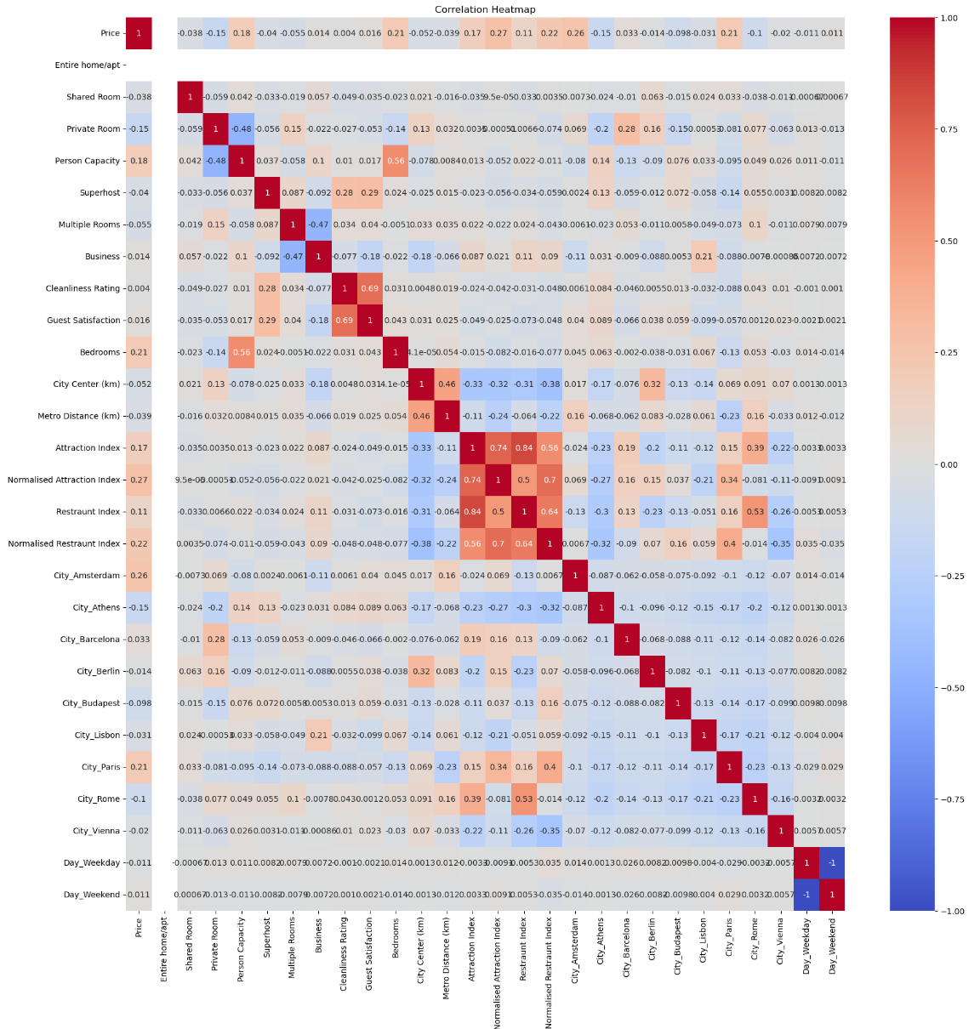
Using Heatmap

Slide 7
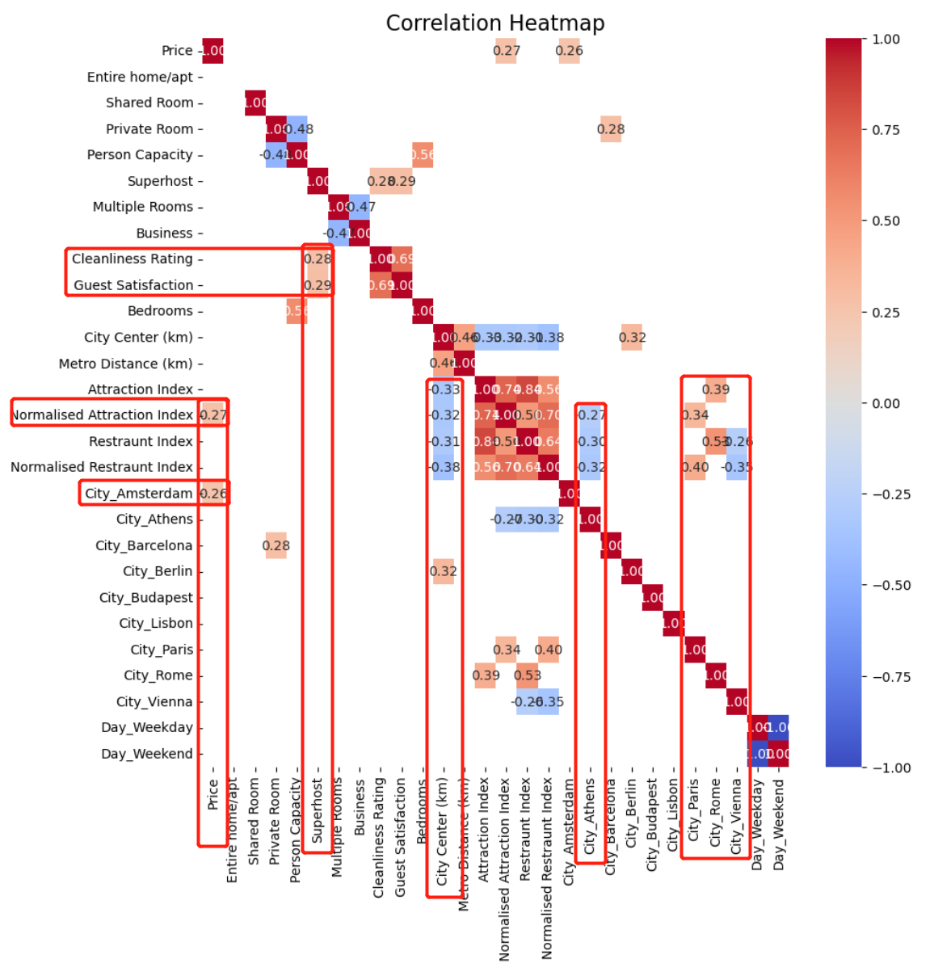
Only the parts of the heatmap with correlation coefficients greater than 0.25 in absolute value were extracted. Here are some pieces of information that can be observed from the heatmap:
The city of Amsterdam has the largest positive impact on prices in terms of the attraction index.
Superhosts were positively correlated with both cleanliness rating and customer satisfaction in the past.
The farther away from the city, the lower all the indices are.
The city of Athens has relatively low values for all indices. The restaurant index is also low in the city of Vienna. Both the cities of Paris and Rome show positive correlations with two indices.

Slide 8
Findings @ EDA Level
Negative correlation between indexes and the distance to the city center and the subway station. We naturally prefer shorter distances.
There is a significant positive correlation between indexes and price.
However, it is harder to comprehend the negative correlation between indexes and Guest Satisfaction and Cleanliness Rating, which seems unreasonable for an attraction.

Slide 9
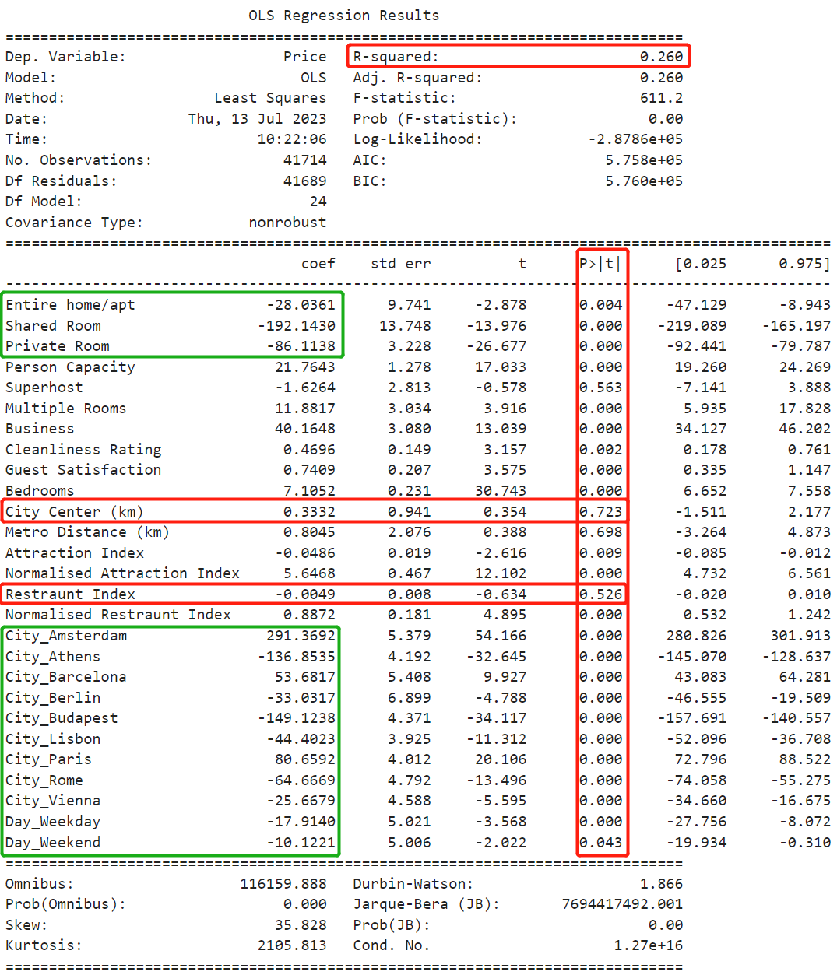
From the results of the regression analysis, the two factors that have the most significant impact on prices are:
City
Room type

Slide 10
Findings @Modeling level
R-square indicate approximately 26% of the variation in the Price can be explained by the independent variables included in the model.
The coefficient -192.143 indicate the negative r/ship and the significant decreases in price when room type is shared room.
The P-value of most of the variables is less than 0.05, indicating their statistical significance in explaining the variation in price.

Slide 11

Visualization Analysis: Prices

Slide 12
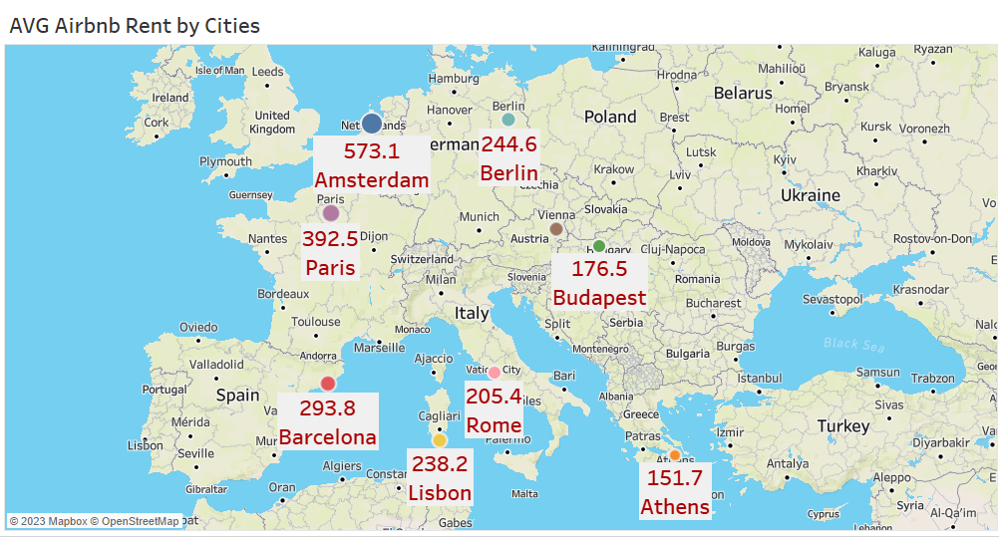

Slide 13
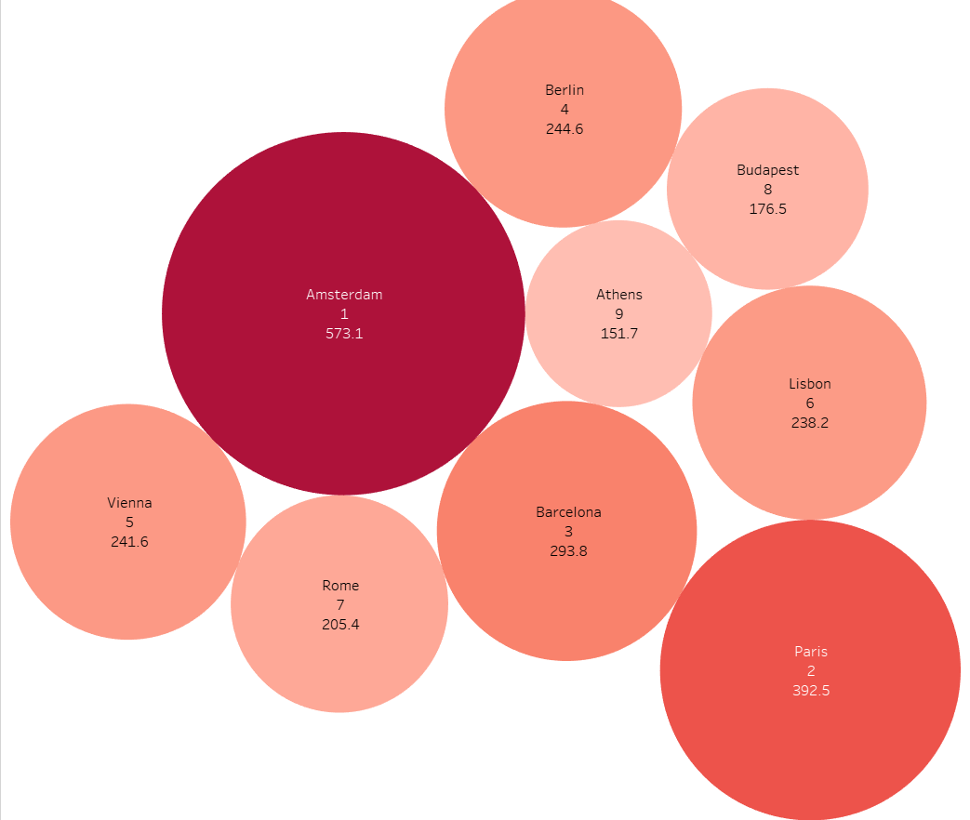
Average Prices and Rankings by City

Slide 14
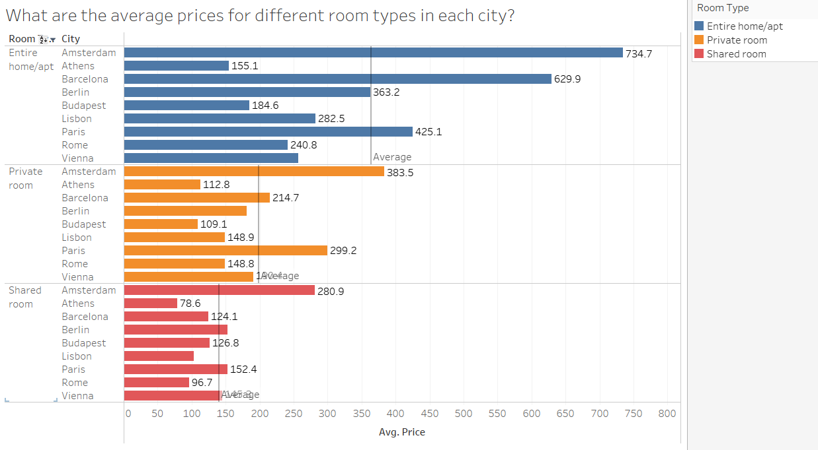

Slide 15
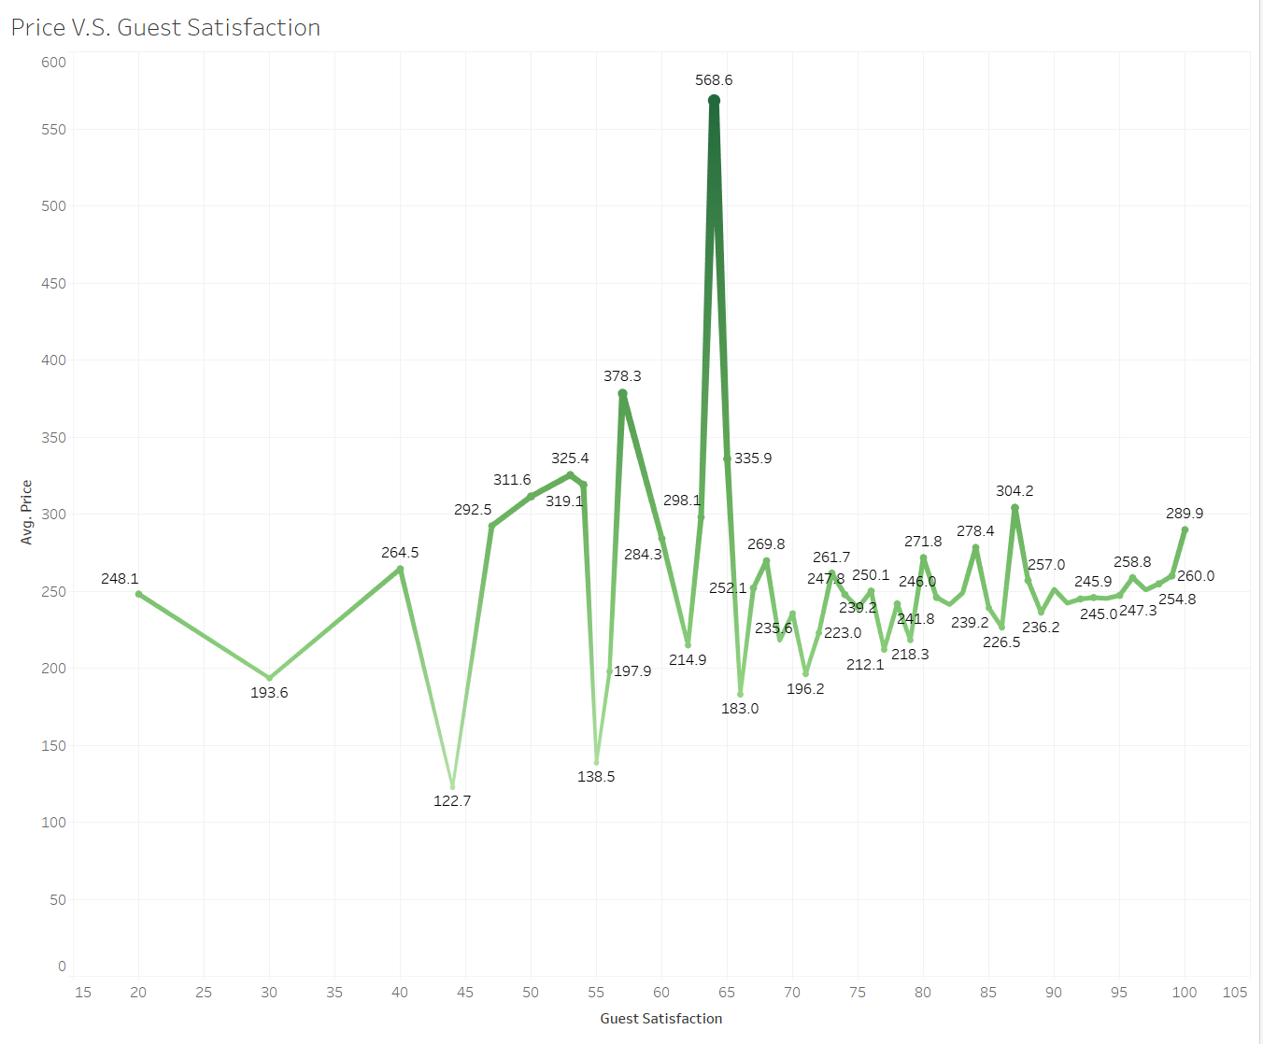
The relationship between customer satisfaction and prices is not clear, but it can be observed that houses with higher average prices tend to have lower overall satisfaction. This could be due to difficulties in meeting customer expectations.

Slide 16
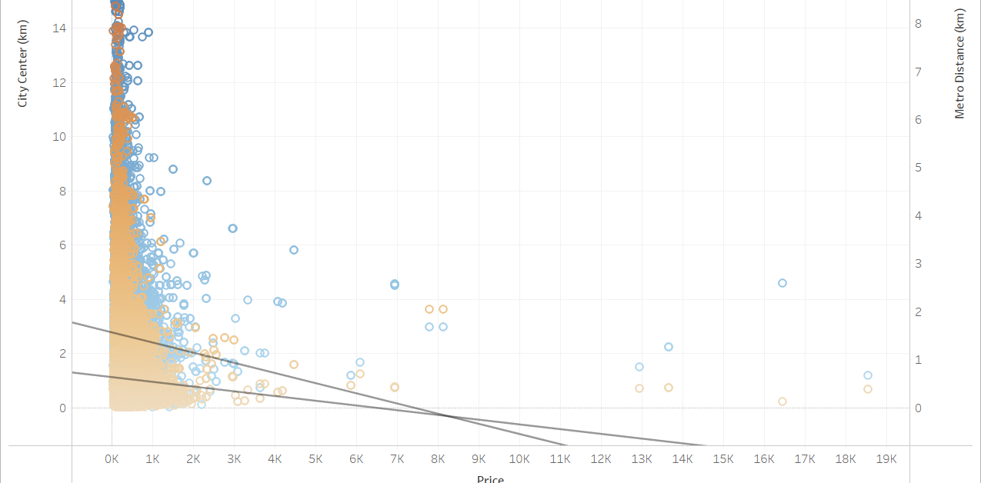

Slide 17
Visualization Analysis: Guest Satisfaction

Slide 18
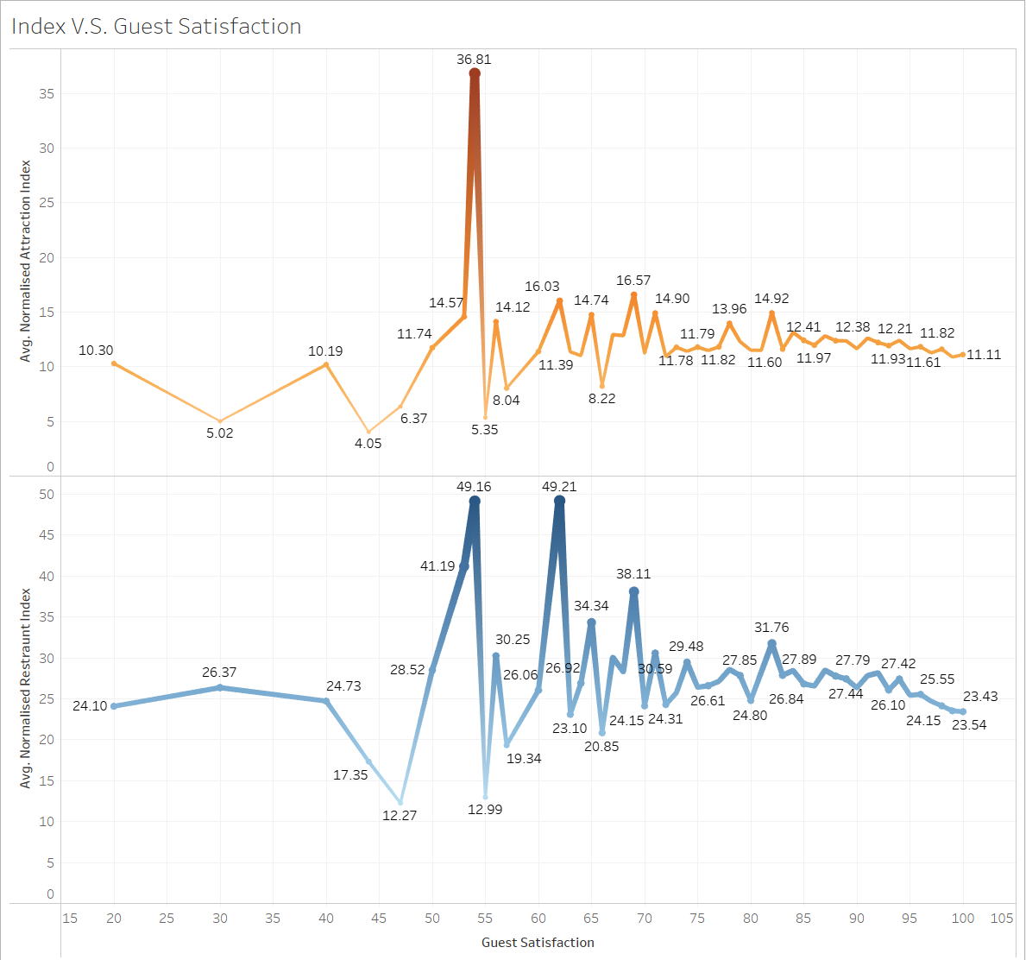

Slide 19
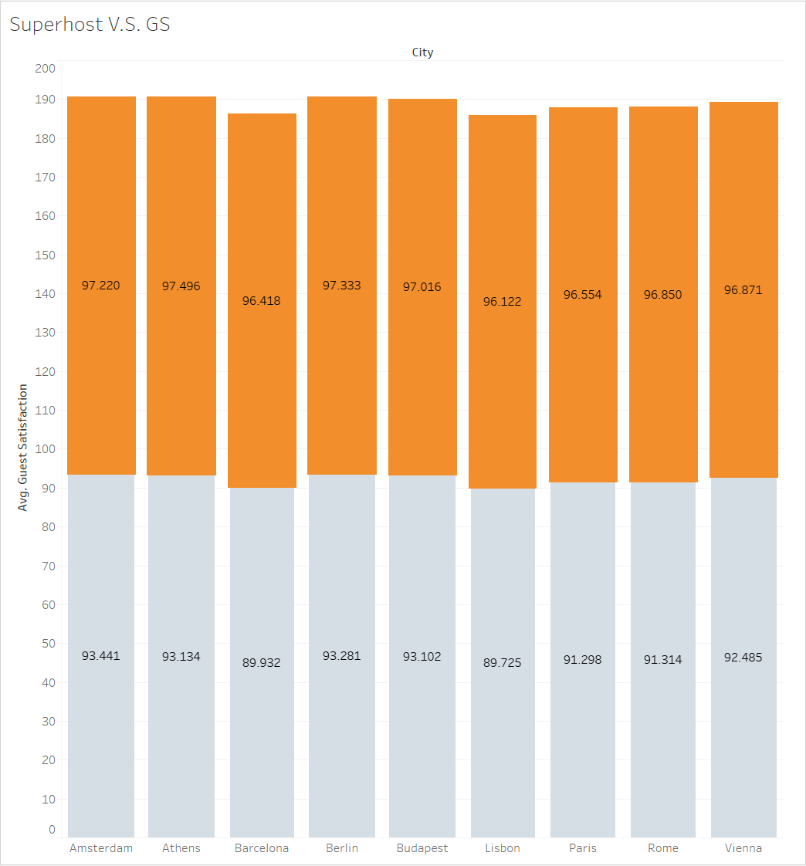
It can be seen that the average guest satisfaction of Superhosts is slightly higher than that of non-Superhosts, but the difference is not significant.

Slide 20
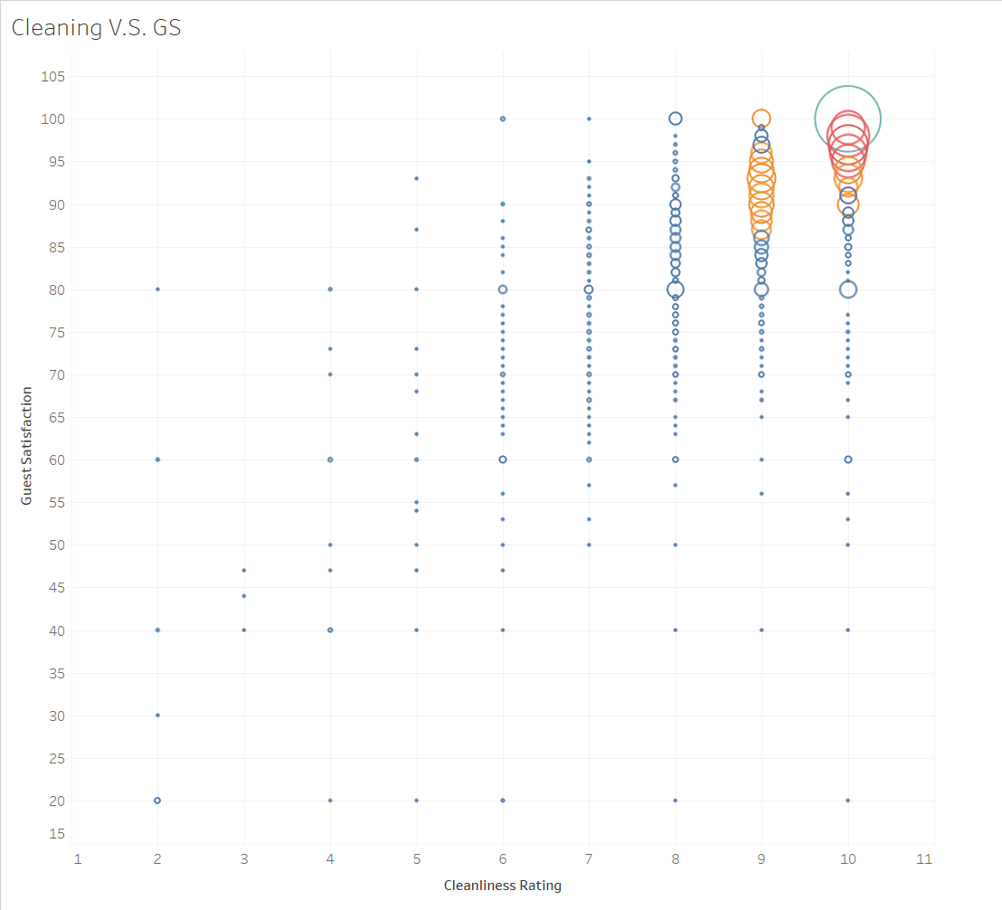
Clearly, higher cleanliness levels lead to higher customer satisfaction.

Slide 21
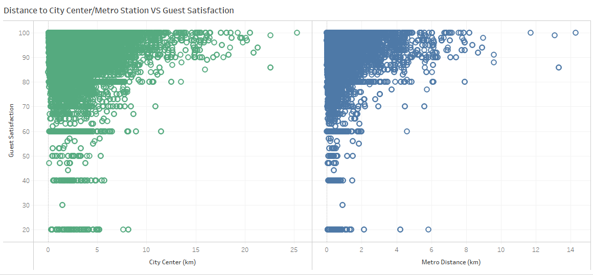

Slide 22
Visualization Analysis: Attraction & Restaurant Indexs

Slide 23
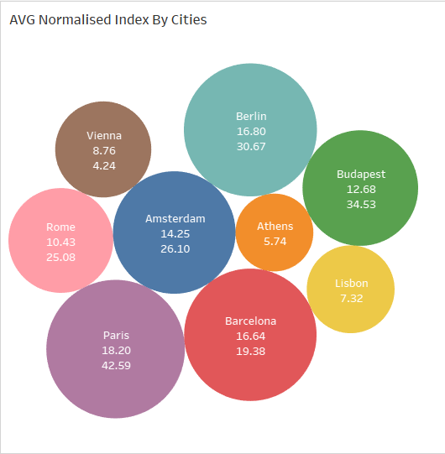

Slide 24
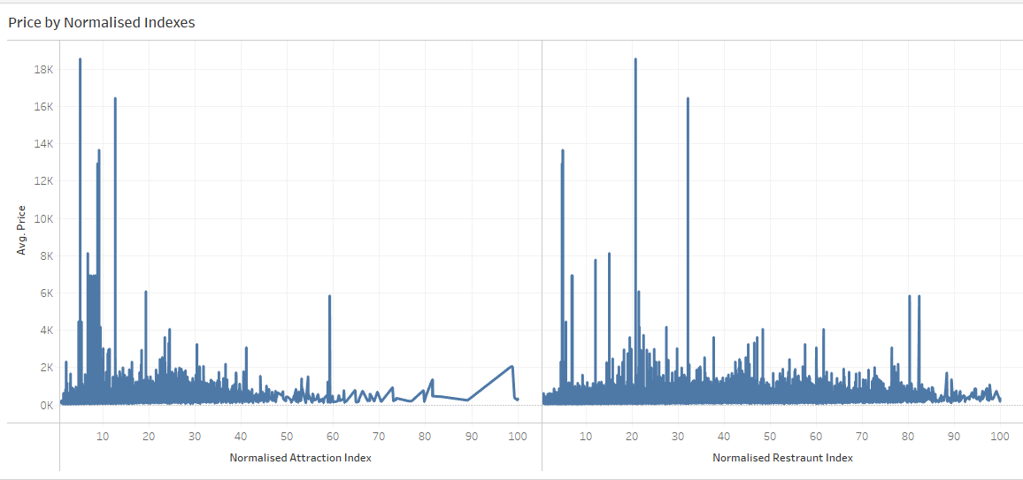

Slide 25
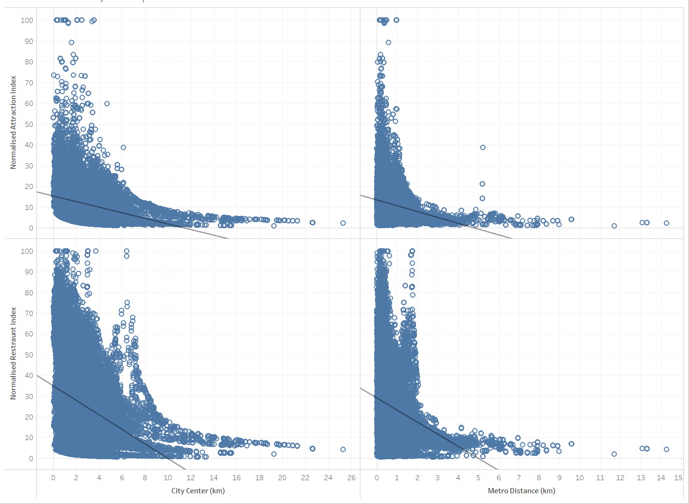

Slide 26
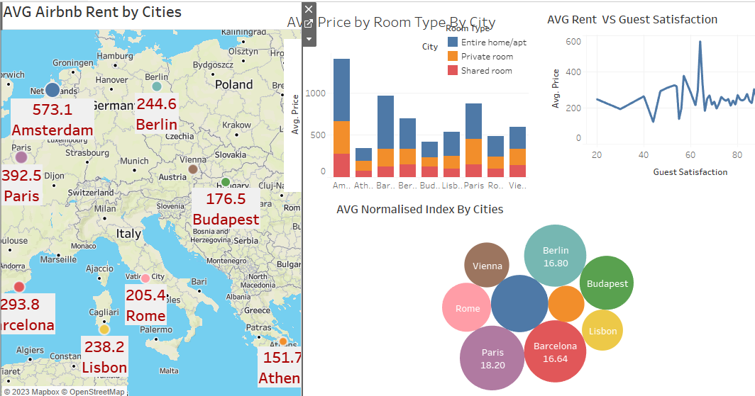

Slide 27
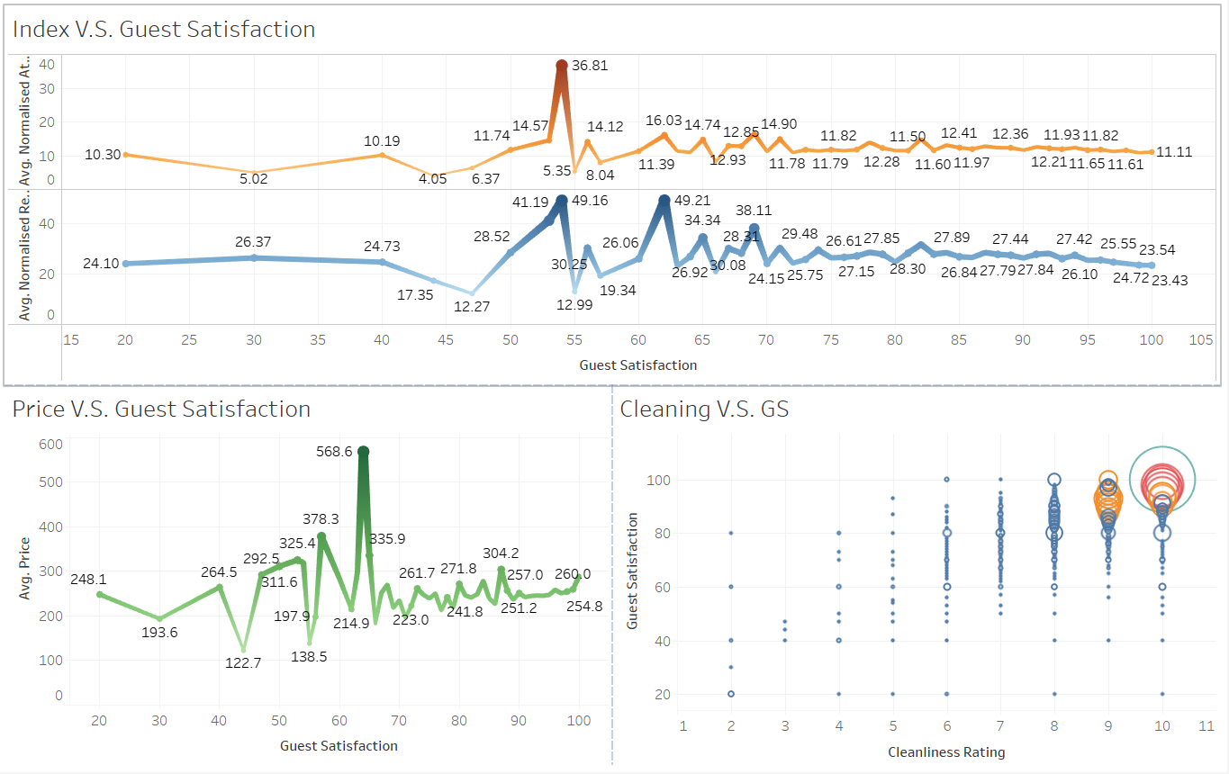

Slide 28
Challenges
Navigating how to work with GitHub as a team member when you must work on the same notebook was not as easy.
Creating robust and highly interactive dashboard needs time & practice.
If we had time, we would have tried creating classification(logistic model) specially with those columns with categorical data type.

Slide 29

THANAK YOU

